Slide 1
Proof of Concept of Lottery Scheduling Machida Hiroaki

Slide 2
Contents
Abstract
Implementation
Result
Challenges
Conclusion

Slide 3
Abstract

Slide 4
Lottery Scheduling can be implemented but there are some unexpected behaviors
Abstract
Problem:
Is Lottery Scheduling implementable by a usual developer?
What are challenges to implement?
Conclusion:
Lottery Scheduling can be implemented, but there are some unexpected behaviors.
The challenges range from setting up development environment to implementation itself.

Slide 5
Implementation

Slide 6
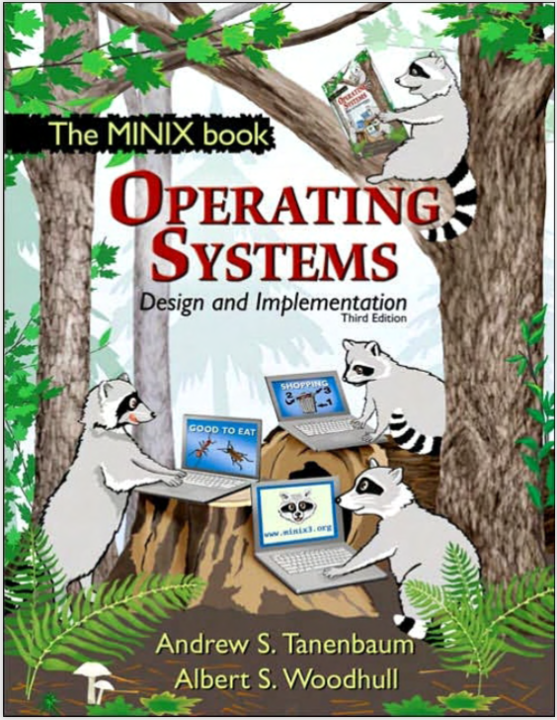
Lottery Scheduling implemented on Minix 3, very simple open-source OS for educational purpose
Implementation: About Minix 3
Minix 3 was originally developed for educational purpose by Andrew S. Tanenbaum. (See Operating Systems Design and Implementation)
Minix 3 is based on microkernel architecture, that has only about 4,000 lines of executable kernel code.
Linus installed MINIX on his computer, wanted to read MINIX newsgroups, but some features lacking, so he wrote a program to do so, terminal driver, and disk driver, file system, then a primitive kernel. That was how Linux was born.

Slide 7
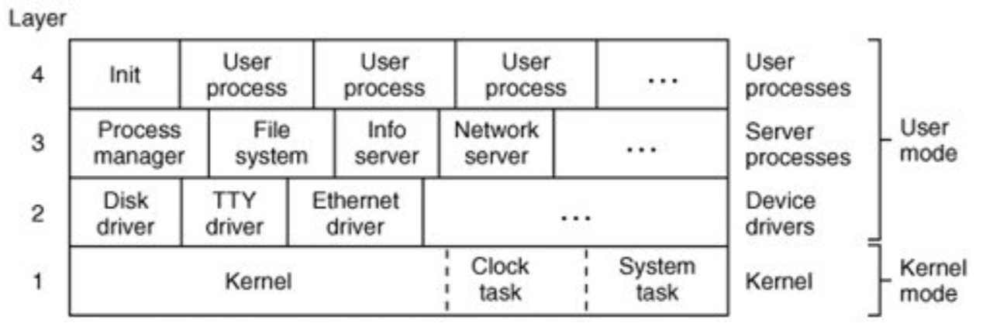
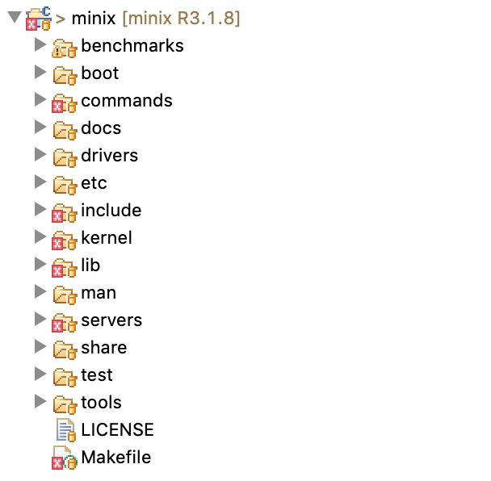
Minix 3 is structured in four layers. Only processes in the bottom layer may use kernel mode instructions.
Implementation: Internal structure of Minix 3
Internal layers
Directory structure
kernel/ layer 1 (scheduling, messages, clock and system tasks).
drivers/ layer 2 (device drivers for disk, console, printer, etc.).
servers/ layer 3 (process manager, file system, other servers).
src/lib/ source code for library procedures (e.g., open, read).
src/tools/ Makefile and scripts for building the MINIX 3 system.
src/boot/ the code for booting and installing MINIX 3.

Slide 8
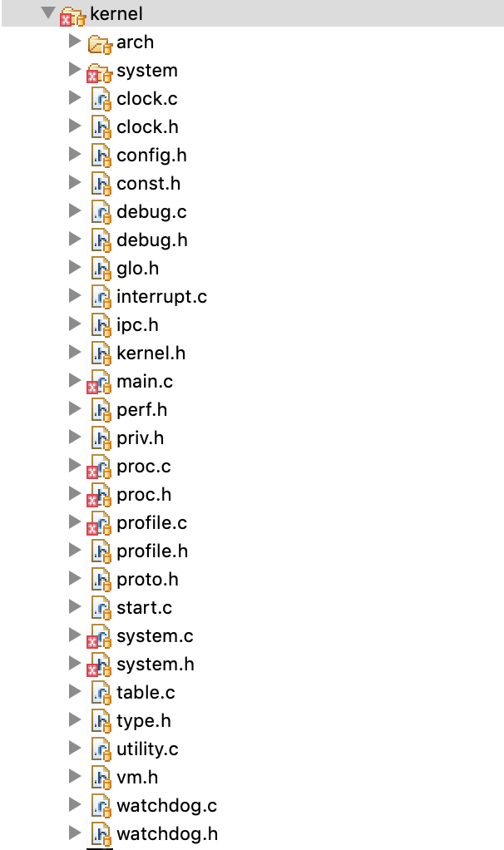
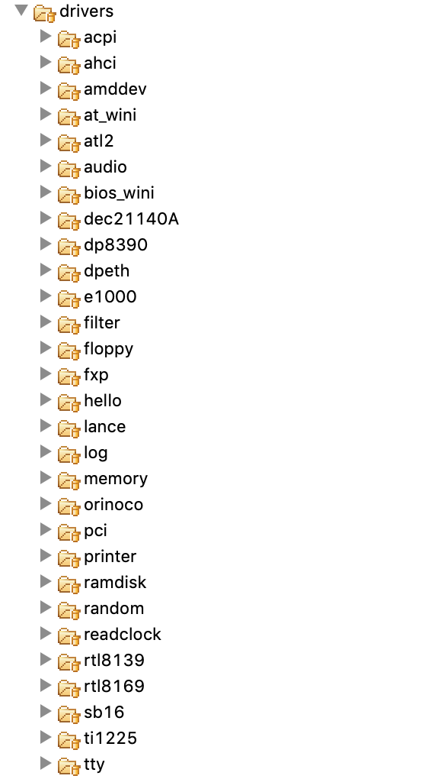
Layer 1 provide a set of privileged kernel calls and layer 2 can request read from or write to I/O ports
Implementation: Layer 1 (Kernel) and 2 (Device drivers)
Layer 1 (Kernel)
Layer 2 (Device drivers)
arch/ Assembly files
system/ Kernel API
proc.c process and message handling.
audio/
floppy/
printer/
tty/ Console and keyboard driver

Slide 9
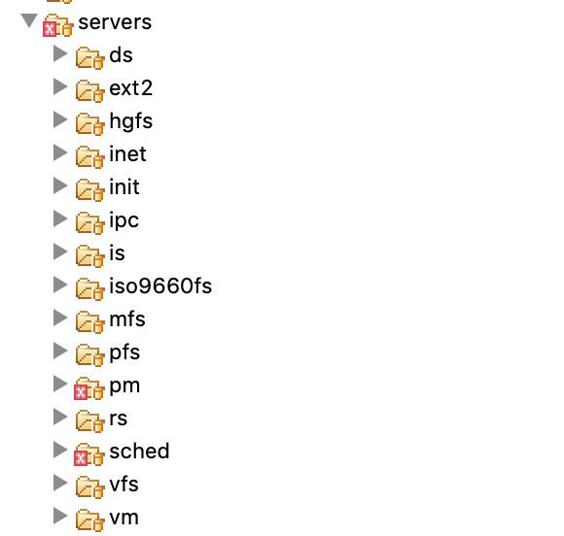
Layer 3 contains servers, processes that provide useful services to the user processes
Implementation: Layer 3 (Servers)
pm/ Process Manager
sched/ Scheduler
vfs/ File system
vm/ Virtual Memory Manager
init/ Parent of all user processes

Slide 10
At 3.1.7 release, Process Scheduler was separated from the kernel for easy customization
Implementation: Change niceness (As-is)
Message flow of changing niceness
A user process invokes the setpriority system routine, which sends a message to PM
PM will look up the scheduler for this particular process and send a message to SCHED with the new value.
SCHED will validate this new nice level and may choose to alter this process’ priority or quantum. In that case, the kernel will be notified with sys_schedule. Once SCHED replies to PM, PM will store the new nice value locally and can serve getpriority requests without contacting SCHED.
Layer
1
2
3
4
User
Process
1
PM
SCHED
User mode
2
3
sys_schedule()
Kernel
Kernel mode

Slide 11
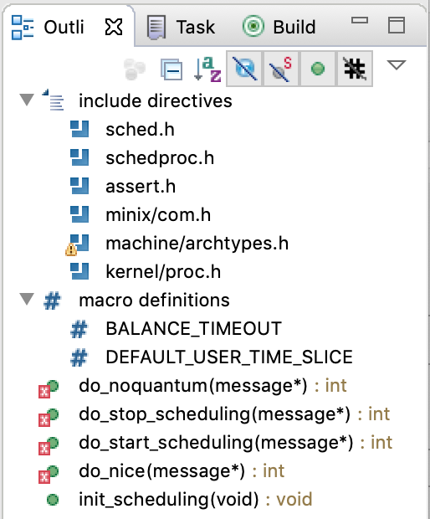
SCHED uses the following methods to handle messages from the Process Manager
Implementation: SCHED(As-is)
sched/schedule.c
do_noquantum()
Called on behalf of process' that run out of quantum
do_stop_scheduling()
Request to start scheduling a proc
do_start_scheduling()
Request to stop scheduling a proc
do_nice()
Request to change the nice level on a proc
Init_scheduling()
Called from main.c to set up/prepare scheduling

Slide 12
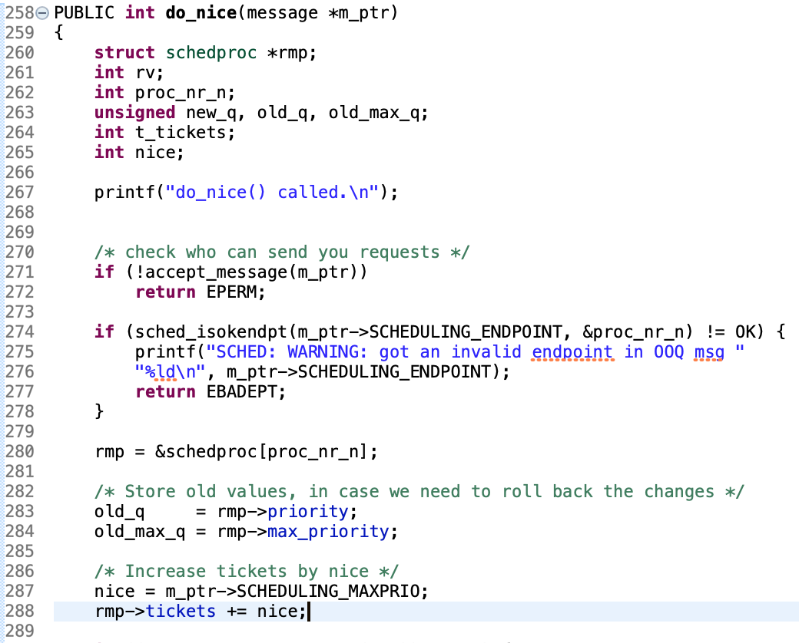
SCHED assigns as many tickets to processes as specified by nice, and does the lottery
Implementation: Lottery Scheduling implementation 1
sched/schedule.c#do_nice()

Slide 13
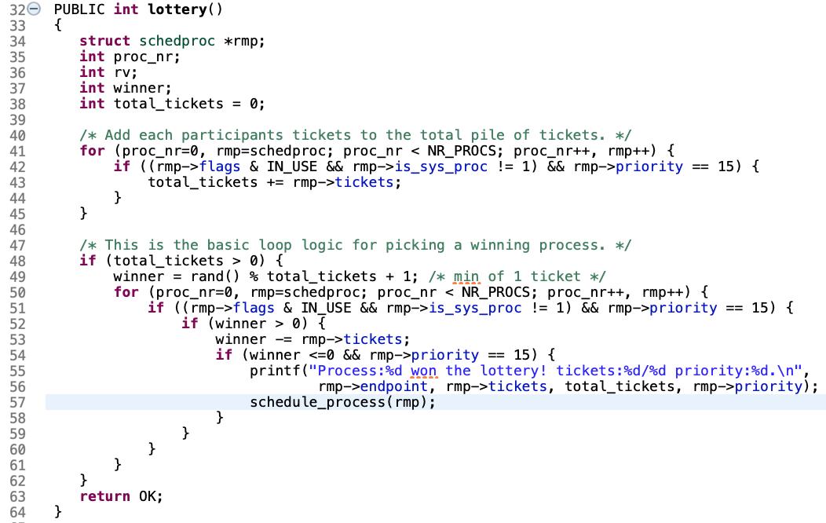
SCHED assigns as many tickets to processes as specified by nice, and does the lottery
Implementation: Lottery Scheduling implementation 2
sched/schedule.c#lottery()

Slide 14
Demo

Slide 15
Result

Slide 16
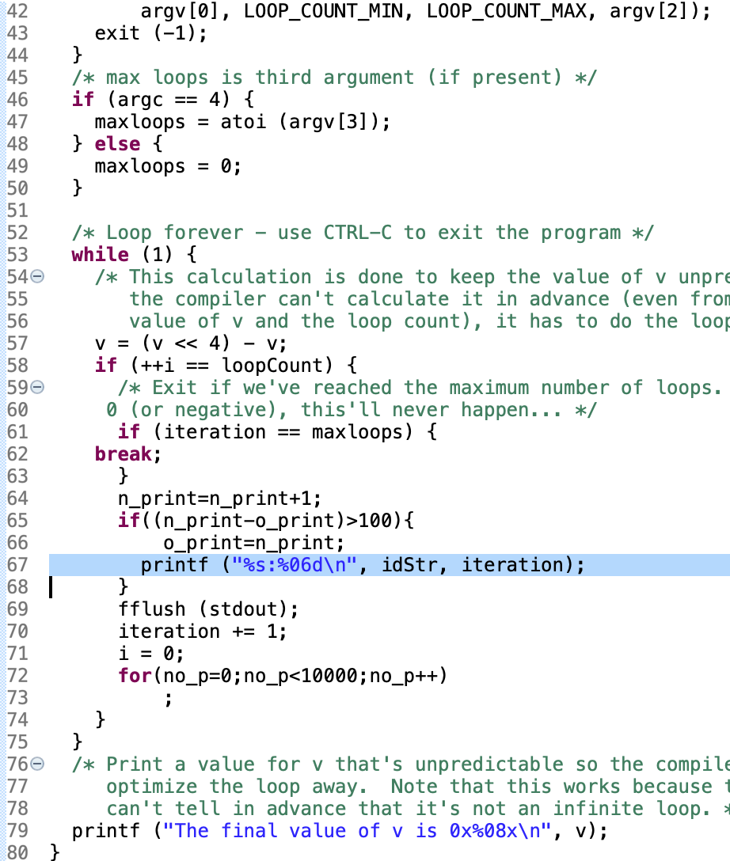
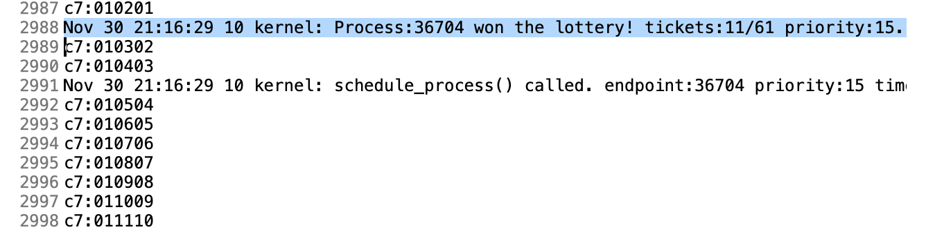
Lottery Scheduling successfully assigns tickets to processes and do the lottery
Result: Same niceness
longrun1.c implementation
Command
nice -n 10 ./a.out a7 100 30000 >> /var/log/messages & nice -n 10 ./a.out b7 100 30000 >> /var/log/messages & nice -n 10 ./a.out c7 100 30000 >> /var/log/messages & nice -n 10 ./a.out d7 100 30000 >> /var/log/messages
/var/log/messages
Progress

Slide 17
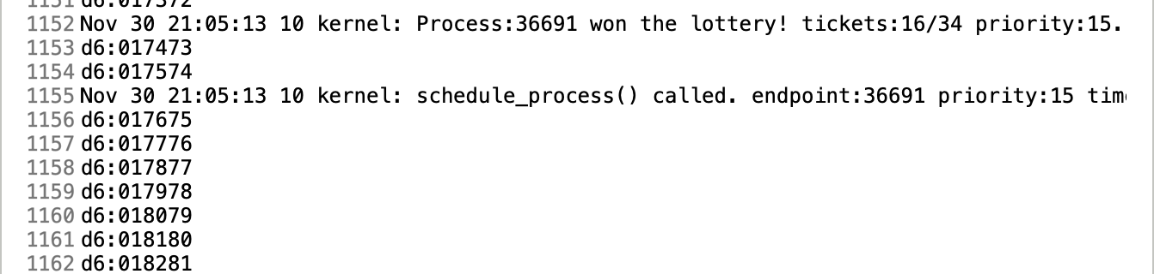
Lottery Scheduling done based on the number of tickets as well
Result: Different niceness
longrun1.c implementation
Command
nice -n 1 ./a.out a6 100 30000 >> /var/log/messages &
nice -n 1 ./a.out b6 100 30000 >> /var/log/messages &
nice -n 1 ./a.out c6 100 30000 >> /var/log/messages &
nice -n 15 ./a.out d6 100 30000 >> /var/log/messages
/var/log/messages
Progress

Slide 18
Challenges

Slide 19
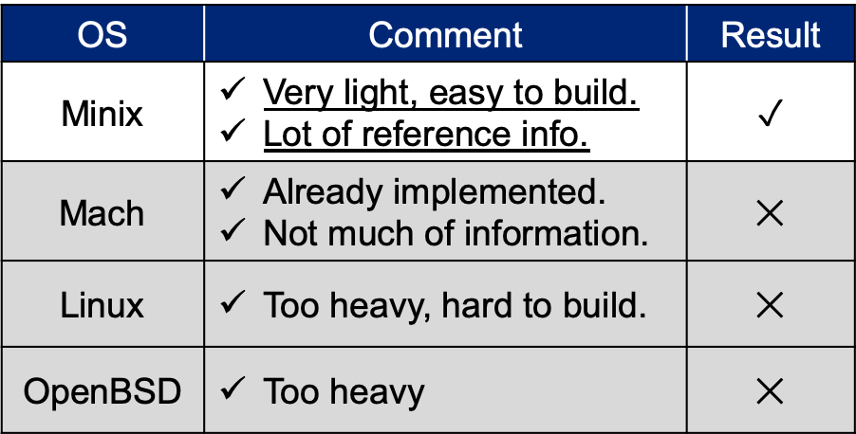
Needed to choose an open source operating system to implement
Challenge 1: Choose OS
Steps for PoC
Evaluation
OS | Comment | Result
Minix | Very light, easy to build. Lot of reference info. | $$✓$$
Mach | Already implemented. Not much of information. | $$✕$$
Linux | Too heavy, hard to build. | $$✕$$
OpenBSD | Too heavy | $$✕$$
Choose open source operating system
Set up environment
Implementation
Solution
Chose Minix.

Slide 20
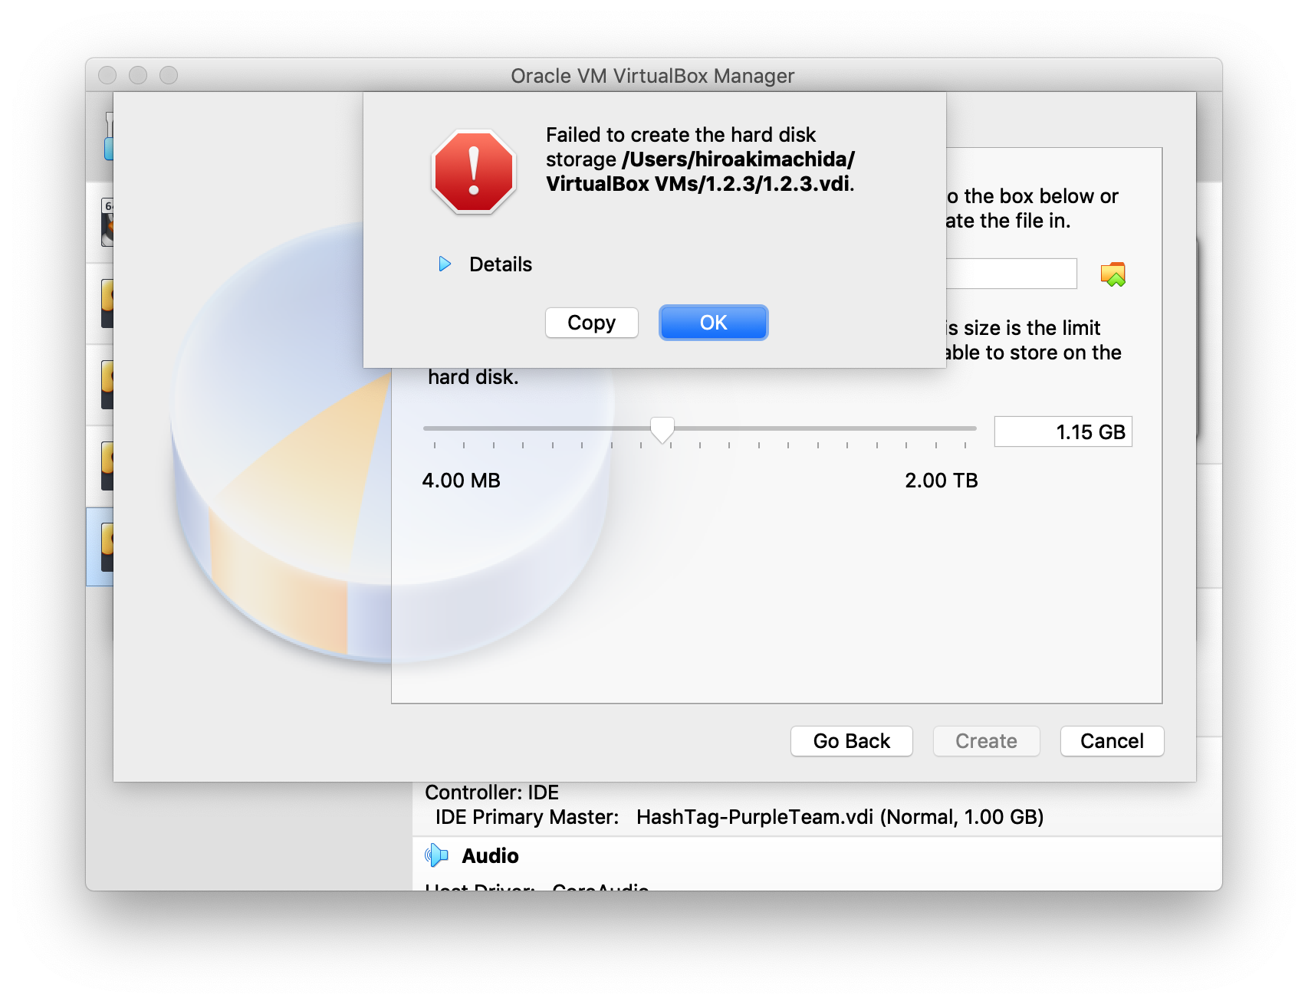
Encountered a VirtualBox bug that the hard disk image cannot be created
Challenge 2: VirtualBox setup
Steps for PoC
Bug
Choose open source operating system
Set up environment
Implementation
Solution
Searched a forum, that took some time, and specified the disk size by bytes.

Slide 21
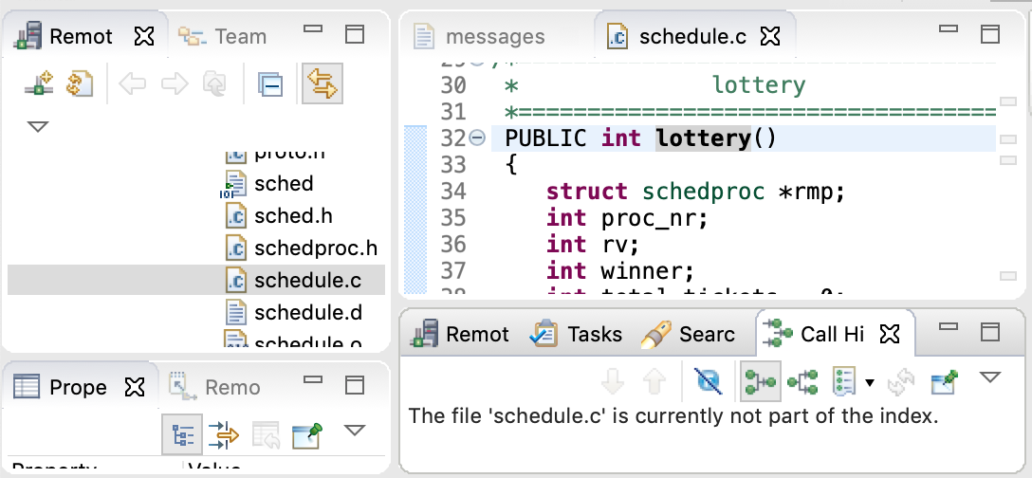
Cannot make the index with Remote System Explorer on Eclipse, neither run debug
Challenge 3: Development environment setup
Steps for PoC
Challenge
Choose open source operating system
Set up environment
Implementation
Solution
Copy the sources into my local and check the codes.
Put printf() function into codes and see if the program works.

Slide 22
Reference project from UCSC didn’t work
Challenge 4: Rereference project
Steps for PoC
Bug
The processes do not work based on tickets
Choose open source operating system
nice -n 0 ./a.out a 100 300000 >> test1 & nice -n 16 ./a.out b 100 300000 >> test1
Set up environment
Implementation
https://github.com/freedombird9/CMPS111-project
Solution
Find other reference projects

Slide 23
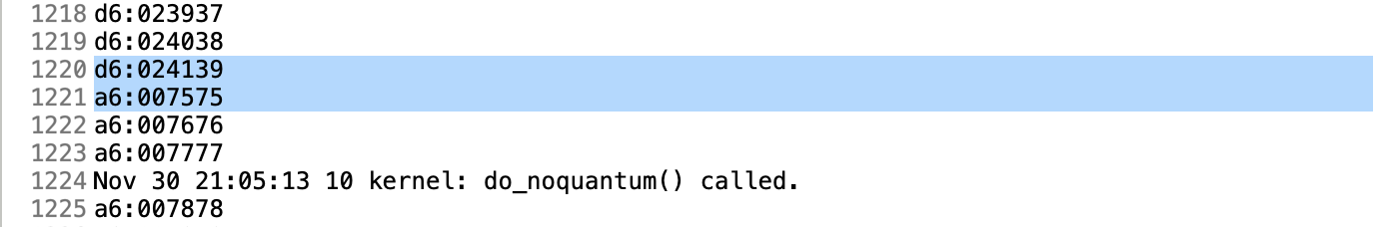
Running process changed without calling sys_schedule() by scheduler
Challenge 5: Unintentional running process change
Steps for PoC
Challenge
Process changed without calling sys_schedule()?
Choose open source operating system
Set up environment
Implementation

Slide 24
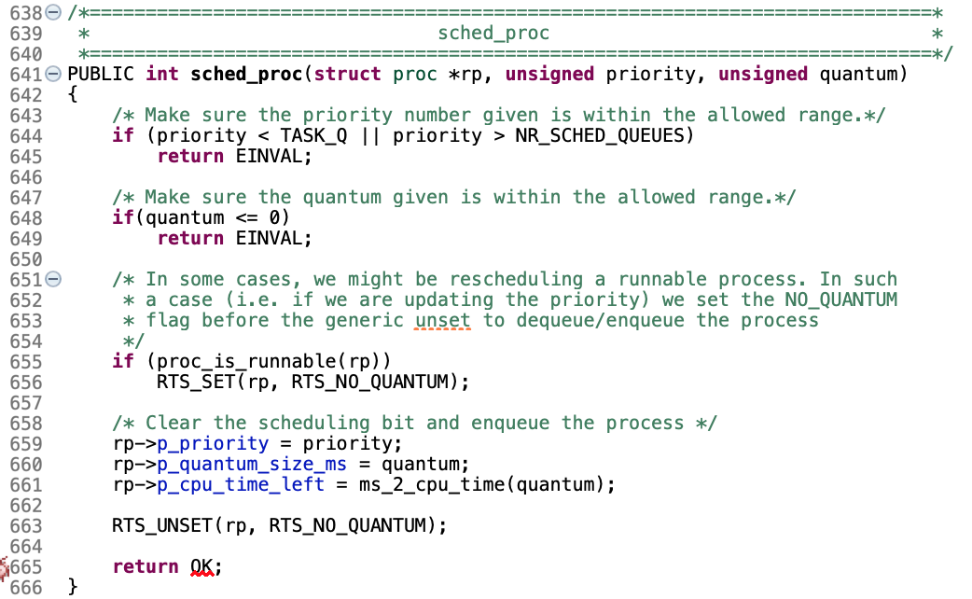
Kernel does round robin even if sys_schedule() is called by a scheduler
Challenge 5: Unintentional running process change
Kernel behavior
kernel/system.c#sched_proc
SCHED
sys_schedule()
calls
Kernel
Solution
(This is specification)

Slide 25
At the beginning all process running at a time, but later running separately
Challenge 6: All processes running at a time
Steps for PoC
Challenge
Only at the beginning all the process running at a time.
Choose open source operating system
Set up environment
Implementation
Round robin by kernel
Solution
(This is specification. The kernel starts round robin a while after the beginning.)

Slide 26
Conclusion

Slide 27
Lottery Scheduling can be implemented but there are some unexpected behaviors
Conclusion
Problem:
Is Lottery Scheduling implementable by a usual developer?
What are challenges to implement?
Conclusion:
Lottery Scheduling can be implemented, but there are some unexpected behaviors.
The challenges range from setting up development environment to implementation itself.

Slide 28
References
“Operating Systems Design and Implementation, Third Edition”
Original Lottery Scheduling Paper
https://www.usenix.org/legacy/publications/library/proceedings/osdi/full_papers/waldspurger.pdf
Minix Official Site
https://www.minix3.org/
Minix Message Flow
http://www.minix3.org/docs/scheduling/report.pdf
Minix Customization
https://github.com/gosaliajigar/CustomizingMINIX3
Reference code from UCSC
https://github.com/freedombird9/CMPS111-project
Reference code from UCSC2
https://github.com/HashTag-PurpleTeam/minix-lottery-scheduler

